Slide 1
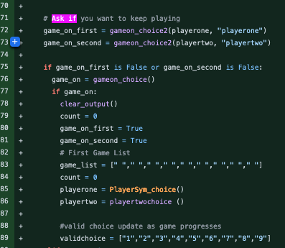
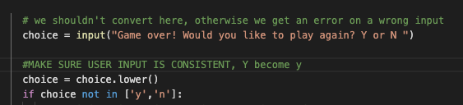
Three in a row
The MAIN concept of this three in a row game is reminiscent of tic tac toe. There are however a couple of tweaks in order to make sure the project runs, not only smoothly but effectively as well.
Once game is over (either playerone or playertwo wins), ask if players want to replay the game. If the player chooses yes, reset the game, clear the board and play again.
When users choose to replay the game, change the answers to lowercase in case users enter “Y”, “N”

